Slide 1
Dynamic meteorology without tears
Part 1 a:
The geostrophic wind

Slide 2
1. What is the “geostrophic” wind?

Slide 3
The weight of all air above defines the pressure at a certain location. It is not evenly distributed in the horisontal and we have graidents in the pressure
1004 hPa
Pressure gradient, from low to high
1008 hPa
1012 hPa
1016 hPa

Slide 4
The wind is acclerated by these pressure differences, from high to low, just like a ball rolling down a hill. This pressure graident force (PGF) is opposite the gradient.
1004 hPa
PGF
1008 hPa
1012 hPa
1016 hPa

Slide 5
But the earth’s rotation, the Coriolis force (2Ω_{φ}V) deflects the acclerated wind to the right (at latitude φ on the Northern Hemísphere)
1004 hPa
PGF
1008 hPa
1012 hPa
1016 hPa

Slide 6
When the pressure gradient force (PGF) and the Coriolis force (2Ω_{φ}V) are equal and opposite the wind moves along the isobars and is said to be “geostrophic”.
PGF
1004 hPa
1008 hPa
V_{g}
1012 hPa
1016 hPa
2Ω_{φ}V

Slide 7
2. How does it look like?

Slide 8
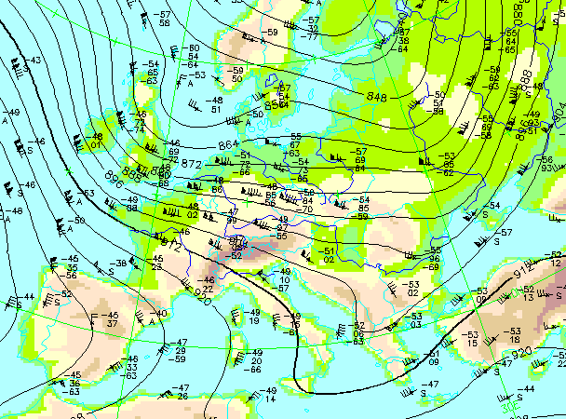
At upper levels, with almost no friction, the wind is more more “geostrophic”

Slide 9
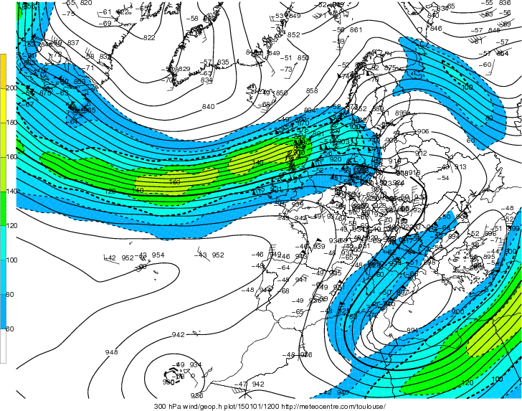

Slide 10
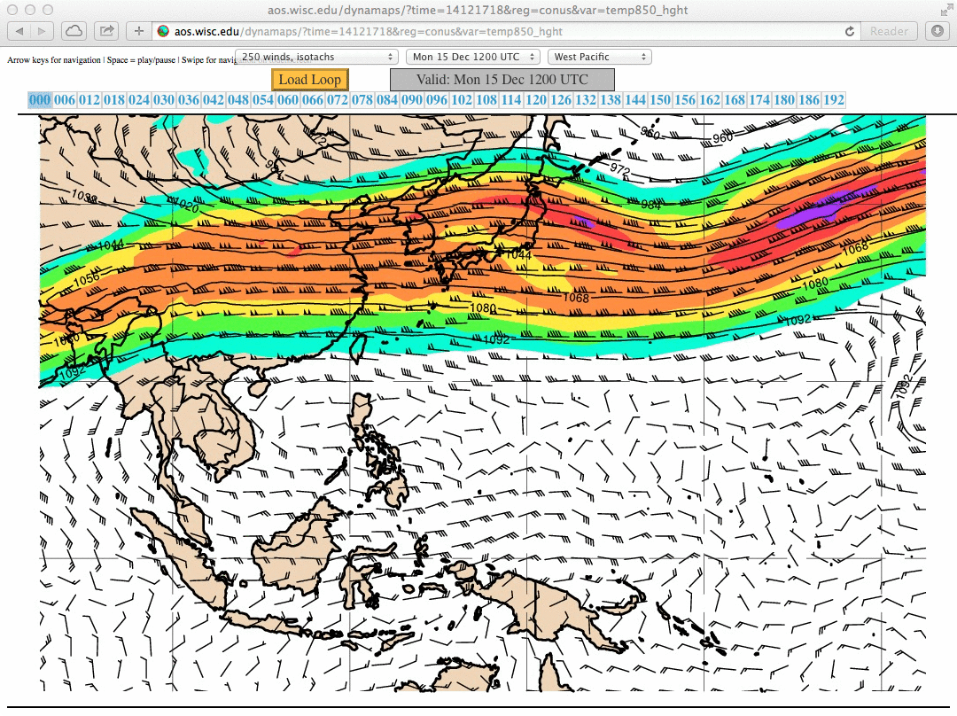

Slide 11
3. How can we calculate it?

Slide 12
How the French Academy derived the geostrophic equation without knowing it!
The Seine
Coriolis!
g
Δs

Slide 13
The Seine
2ΩVsinϕ=fV
Δz
Δs
g

Slide 14
4. The role of friction

Slide 15
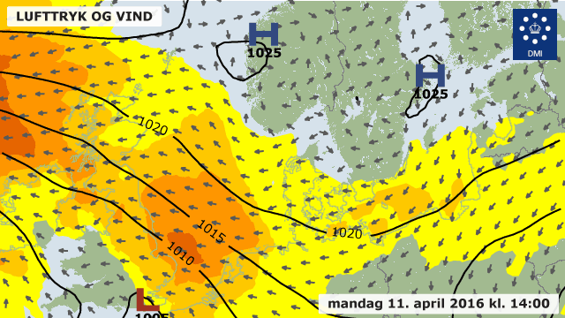
The sea surface pressure and wind just now, Monday 11 April 2016 at midday
Because of friction the wind is pointing slightly towards lower pressure

Slide 16
If there is friction (F) against the motion, there will be balance only if the wind (V) turns towards low pressure and will no longer be “geostrophic” (V_{g})
PGF
V
1004 hPa
1008 hPa
F
V_{g}
1012 hPa
1016 hPa
2Ω_{φ}V

Slide 17
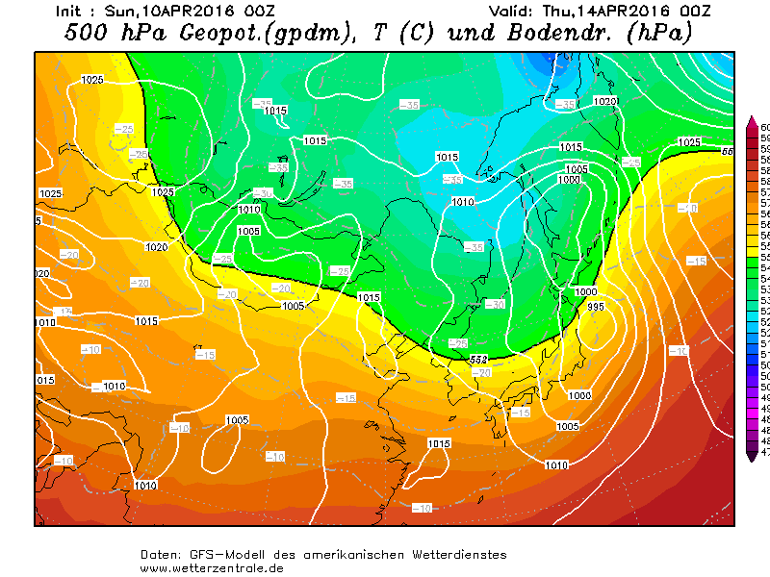

Slide 18
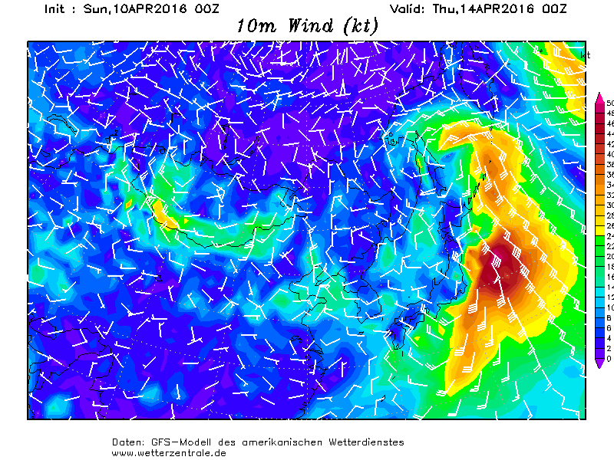

Slide 20
5. How to use it to read weather maps

Slide 21
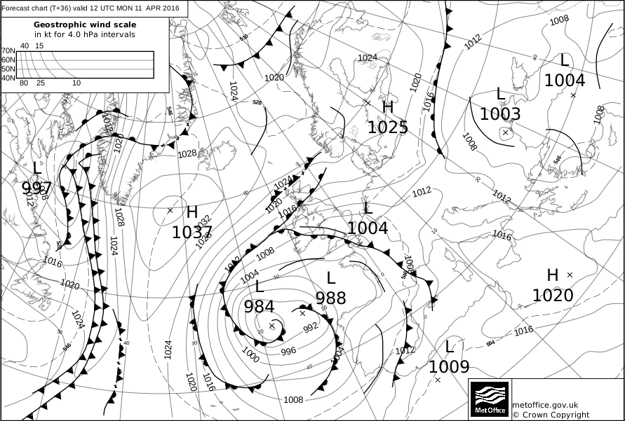

Slide 22
The sea surface pressure and wind just now, Monday 11 April 2016 at midday

Slide 24
10 m/s

Slide 25
30 m/s

Slide 26
6. But if the wind is not “geostrophic”????

Slide 27
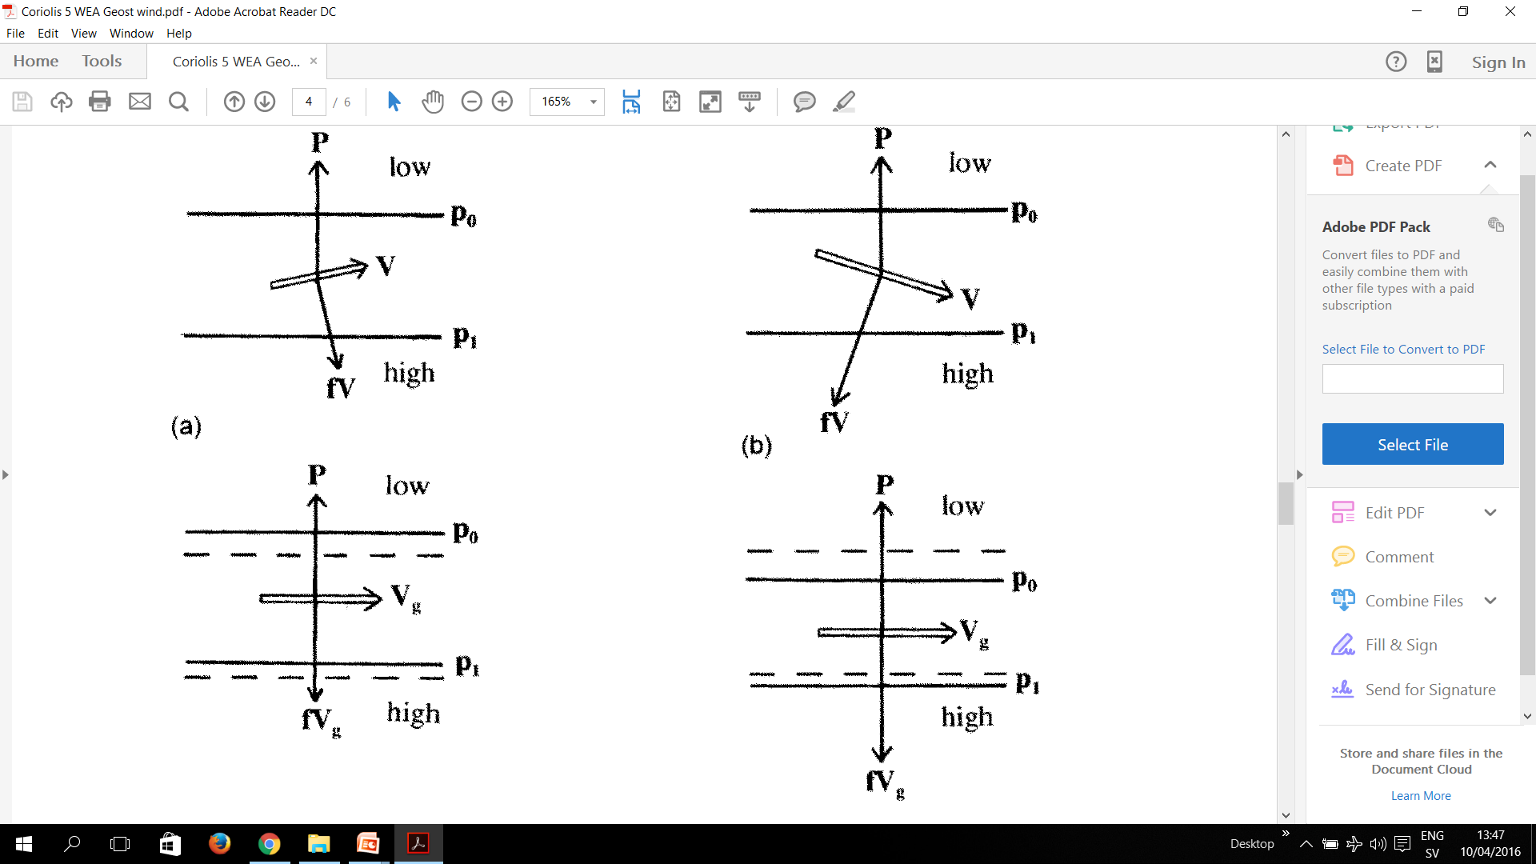
Then the wind and the pressure field adjust towards each other
If the wind is weaker than the “geostrophic”, the PGF will accelerate it “downhill” towards lower pressure and make the wind stronger.
At the same time this will also transport air and weaken the pressure gradient.
Wind and pressure will adjust towards each other

Slide 28
Then the wind and the pressure field adjust towards each other
If the wind is stronger than the “geostrophic”, the PGF will accelerate it “uphill” towards higher pressure and make the wind weaker.
At the same time this will also transport air and strengthen the pressure gradient.
Wind and pressure will adjust towards each other

Slide 29
END

